Slide 1
Activities and Intents
Android Developer Fundamentals V2
Lesson 2

Slide 2
2.2 Activity lifecycle
and state

Slide 3
Contents
Activity lifecycle
Activity lifecycle callbacks
Activity instance state
Saving and restoring Activity state

Slide 4
Activity lifecycle

Slide 5
What is the Activity Lifecycle?
The set of states an Activity can be in during its lifetime, from when it is created until it is destroyed
More formally:
A directed graph of all the states an Activity can be in, and the callbacks associated with transitioning from each state to the next one

Slide 6
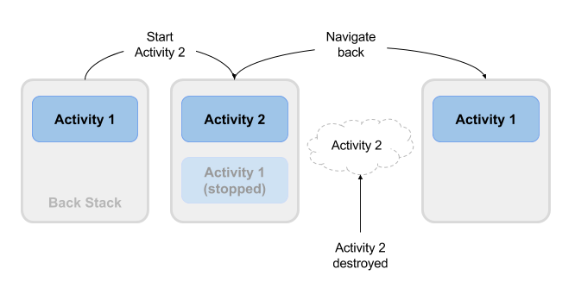
What is the Activity Lifecycle?

Slide 7



Activity states and app visibility
Created (not visible yet)
Started (visible)
Resume (visible)
Paused(partially invisible)
Stopped (hidden)
Destroyed (gone from memory)
State changes are triggered by user action, configuration changes such as device rotation, or system action

Slide 8
Activity lifecycle callbacks

Slide 9


Callbacks and when they are called
onCreate(Bundle savedInstanceState)—static initialization
onStart()—when Activity (screen) is becoming visible
onRestart()—called if Activity was stopped (calls onStart())
onResume()—start to interact with user
onPause()—about to resume PREVIOUS Activity
onStop()—no longer visible, but still exists and all state info preserved
onDestroy()—final call before Android system destroys Activity

Slide 10
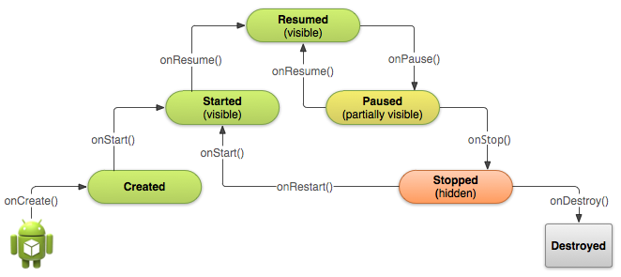
Activity states and callbacks graph

Slide 11
Implementing and overriding callbacks
Only onCreate() is required
Override the other callbacks to change default behavior

Slide 12
onCreate() –> Created
Called when the Activity is first created, for example when user taps launcher icon
Does all static setup: create views, bind data to lists, ...
Only called once during an activity's lifetime
Takes a Bundle with Activity's previously frozen state, if there was one
Created state is always followed by onStart()

Slide 13
onCreate(Bundle savedInstanceState)
@Override
public void onCreate(Bundle savedInstanceState) {
super.onCreate(savedInstanceState);
// The activity is being created.
}

Slide 14
onStart() –> Started
Called when the Activity is becoming visible to user
Can be called more than once during lifecycle
Followed by onResume() if the activity comes to the foreground, or onStop() if it becomes hidden

Slide 15
onStart()
@Override
protected void onStart() {
super.onStart();
// The activity is about to become visible.
}

Slide 16
onRestart() –> Started
Called after Activity has been stopped, immediately before it is started again
Transient state
Always followed by onStart()

Slide 17
onRestart()
@Override
protected void onRestart() {
super.onRestart();
// The activity is between stopped and started.
}

Slide 18
onResume() –> Resumed/Running
Called when Activity will start interacting with user
Activity has moved to top of the Activity stack
Starts accepting user input
Running state
Always followed by onPause()

Slide 19
onResume()
@Override
protected void onResume() {
super.onResume();
// The activity has become visible
// it is now "resumed"
}

Slide 20
onPause() –> Paused
Called when system is about to resume a previous Activity
The Activity is partly visible but user is leaving the Activity
Typically used to commit unsaved changes to persistent data, stop animations and anything that consumes resources
Implementations must be fast because the next Activity is not resumed until this method returns
Followed by either onResume() if the Activity returns back to the front, or onStop() if it becomes invisible to the user

Slide 21
onPause()
@Override
protected void onPause() {
super.onPause();
// Another activity is taking focus
// this activity is about to be "paused"
}

Slide 22
onStop() –> Stopped
Called when the Activity is no longer visible to the user
New Activity is being started, an existing one is brought in front of this one, or this one is being destroyed
Operations that were too heavy-weight for onPause()
Followed by either onRestart() if Activity is coming back to interact with user, or onDestroy() if Activity is going away

Slide 23
onStop()
@Override
protected void onStop() {
super.onStop();
// The activity is no longer visible
// it is now "stopped"
}

Slide 24
onDestroy() –> Destroyed
Final call before Activity is destroyed
User navigates back to previous Activity, or configuration changes
Activity is finishing or system is destroying it to save space
Call isFinishing() method to check
System may destroy Activity without calling this, so use onPause() or onStop() to save data or state

Slide 25
onDestroy()
@Override
protected void onDestroy() {
super.onDestroy();
// The activity is about to be destroyed.
}

Slide 26
Activity instance state

Slide 27
When does config change?
Configuration changes invalidate the current layout or other resources in your activity when the user:
Rotates the device
Chooses different system language, so locale changes
Enters multi-window mode (from Android 7)

Slide 28
What happens on config change?
On configuration change, Android:
1. Shuts down Activity by calling:
2. Starts Activity over again by calling:
onPause()
onStop()
onDestroy()
onCreate()
onStart()
onResume()

Slide 29




Activity instance state
State information is created while the Activity is running, such as a counter, user text, animation progression
State is lost when device is rotated, language changes, back-button is pressed, or the system clears memory

Slide 30
Saving and restoring Activity state

Slide 31


What the system saves
System saves only:
State of views with unique ID (android:id) such as text entered into EditText
Intent that started activity and data in its extras
You are responsible for saving other activity and user progress data

Slide 32
Saving instance state
Implement onSaveInstanceState() in your Activity
Called by Android runtime when there is a possibility the Activity may be destroyed
Saves data only for this instance of the Activity during current session

Slide 33
onSaveInstanceState(Bundle outState)
@Override
public void onSaveInstanceState(Bundle outState) {
super.onSaveInstanceState(outState);
// Add information for saving HelloToast counter
// to the to the outState bundle
outState.putString("count",
String.valueOf(mShowCount.getText()));
}

Slide 34










Restoring instance state
Two ways to retrieve the saved Bundle
in onCreate(Bundle mySavedState) Preferred, to ensure that your user interface, including any saved state, is back up and running as quickly as possible
Implement callback (called after onStart()) onRestoreInstanceState(Bundle mySavedState)
=null -> dữ liệu tạo mới trong
Lần chạy app ban đầu . khác null ->
Đã có dữ liệu được lưu

Slide 35
Restoring in onCreate()
@Override
protected void onCreate(Bundle savedInstanceState) {
super.onCreate(savedInstanceState);
setContentView(R.layout.activity_main);
mShowCount = findViewById(R.id.show_count);
if (savedInstanceState != null) {
String count = savedInstanceState.getString("count");
if (mShowCount != null)
mShowCount.setText(count);
}
}

Slide 36
onRestoreInstanceState(Bundle state)
@Override
public void onRestoreInstanceState (Bundle mySavedState) {
super.onRestoreInstanceState(mySavedState);
if (mySavedState != null) {
String count = mySavedState.getString("count");
if (count != null)
mShowCount.setText(count);
}
}

Slide 37
Instance state and app restart
When you stop and restart a new app session, the Activity instance states are lost and your activities will revert to their default appearance
If you need to save user data between app sessions, use shared preferences or a database.

Slide 38
Learn more
Activities (API Guide)
Activity (API Reference)
Managing the Activity Lifecycle
Pausing and Resuming an Activity
Stopping and Restarting an Activity
Recreating an Activity
Handling Runtime Changes
Bundle

Slide 39
What's Next?
Concept Chapter: 2.2 Activity lifecycle and state
Practical: 2.2 Activity lifecycle and state

Slide 40
END

